Slide 1
Consumers, Producers, and the Efficiency of Markets
CHAPTER 7
Notes:
N. Gregory Mankiw Principles Of Economics Eight Edition

Slide 2
Consumer Surplus, Part 1
Welfare economics
The study of how the allocation of resources affects economic well-being
Benefits that buyers and sellers receive from engaging in market transactions
How society can make these benefits as large as possible
In any market, the equilibrium of supply and demand maximizes the total benefits received by all buyers and sellers combined

Slide 3
Consumer Surplus, Part 2
Willingness to pay
Maximum amount that a buyer will pay for a good
How much that buyer values the good
Consumer surplus
Amount a buyer is willing to pay for a good minus amount the buyer actually pays
Willingness to pay minus price paid

Slide 4
Table 1 Four Possible Buyers’ Willingness to Pay
Buyer | Willingness to Pay
Taylor | $100
Carrie | 80
Rihanna | 70
Gaga | 50

Slide 5
Consumer Surplus, Part 3
Consumer surplus
Measures the benefit buyers receive from participating in a market
Closely related to the demand curve
Demand schedule
Derived from the willingness to pay of the possible buyers

Slide 6
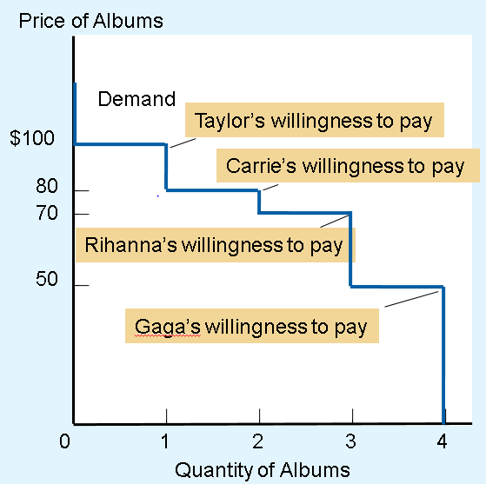
Figure 1 The Demand Schedule and the Demand Curve
Price | Buyers | Quantity Demanded
More than $100 | None | 0
$80 to $100 | Taylor | 1
$70 to $80 | Taylor, Carrie | 2
$50 to $70 | Taylor, Carrie, Rihanna | 3
$50 or less | Taylor, Carrie, Rihanna, Gaga | 4
The table shows the demand schedule for the buyers (listed in Table 1) of the mint-condition copy of Elvis Presley’s first album. The graph shows the corresponding demand curve. Note that the height of the demand curve reflects the buyers’ willingness to pay.

Slide 7
Consumer Surplus, Part 4
At any quantity, the price given by the demand curve
Shows the willingness to pay of the marginal buyer
The buyer who would leave the market first if the price were any higher
Consumer surplus in a market
Area below the demand curve and above the price

Slide 8
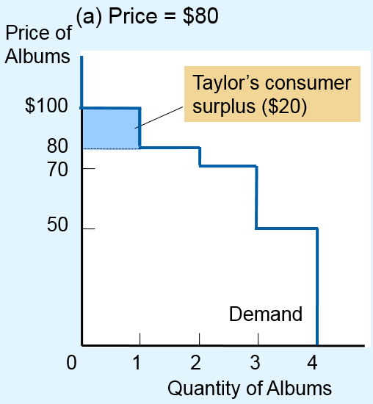
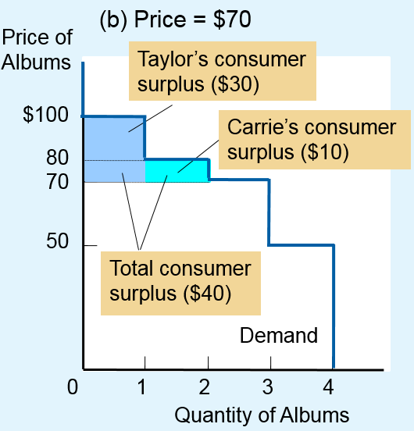
Figure 2 Measuring Consumer Surplus with the Demand Curve
In panel (a), the price of the good is $80 and the consumer surplus is $20.
In panel (b), the price of the good is $70 and the consumer surplus is $40.

Slide 9
Consumer Surplus, Part 5
A lower price raises consumer surplus
Existing buyers: increase in consumer surplus
Buyers who were already buying the good at the higher price are better off because they now pay less
New buyers enter the market: increase in consumer surplus
Willing to buy the good at the lower price

Slide 10
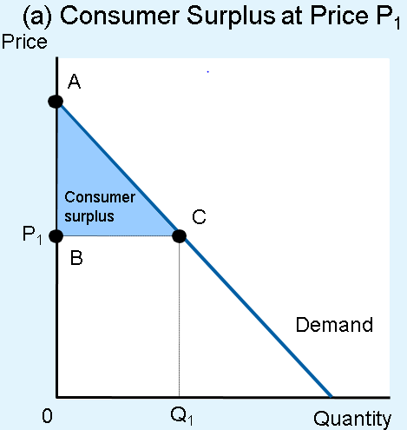
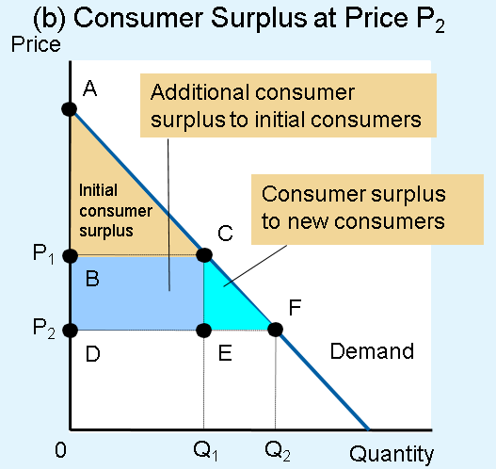
Figure 3 How Price Affects Consumer Surplus
In panel (a), the price is P₁, the quantity demanded is Q₁, and consumer surplus equals the area of the triangle ABC.
When the price falls from P₁ to P₂, as in panel (b), the quantity demanded rises from Q₁ to Q₂ and the consumer surplus rises to the area of the triangle ADF. The increase in consumer surplus (area BCFD) occurs in part because existing consumers now pay less (area BCED) and in part because new consumers enter the market at the lower price (area CEF).

Slide 11
Consumer Surplus, Part 6
Consumer surplus
Benefit that buyers receive from a good
As the buyers themselves perceive it
Good measure of economic well-being
Exception: illegal drugs
Drug addicts are willing to pay a high price for heroin
Society’s standpoint: drug addicts don’t get a large benefit from being able to buy heroin at a low price

Slide 12
Producer Surplus, Part 1
Cost
Value of everything a seller must give up to produce a good
Measure of willingness to sell
Producer surplus
Amount a seller is paid for a good minus the seller’s cost of providing it
Price received minus willingness to sell

Slide 13
Table 2 The Costs of Four Possible Sellers
Seller | Cost
Vincent | $900
Claude | 800
Pablo | 600
Andy | 500

Slide 14
Producer Surplus, Part 2
Producer surplus
Closely related to the supply curve
Supply schedule
Derived from the costs of the suppliers
At any quantity
Price given by the supply curve shows the cost of the marginal seller
Seller who would leave the market first if the price were any lower

Slide 15
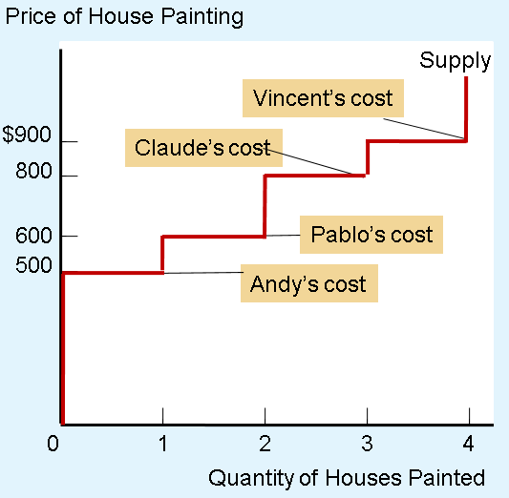
Figure 4 The Supply Schedule and Supply Curve
Price | Sellers | Quantity Demanded
$900 or more | Vincent, Claude, Pablo, Andy | 4
$800 to $900 | Claude, Pablo, Andy | 3
$600 to $800 | Pablo, Andy | 2
$500 to $600 | Andy | 1
Less than $500 | None | 0
The table shows the supply schedule for the sellers (listed in Table 2) of painting services. The graph shows the corresponding supply curve. Note that the height of the supply curve reflects the sellers’ costs.

Slide 16
Producer Surplus, Part 3
Supply curve
Reflects sellers’ costs
Used to measure producer surplus
Producer surplus in a market
Area below the price and above the supply curve

Slide 17
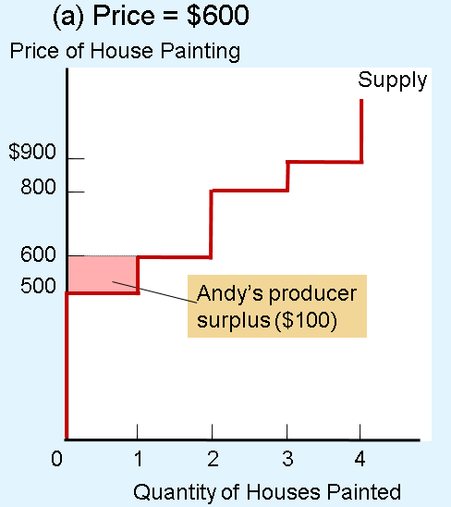
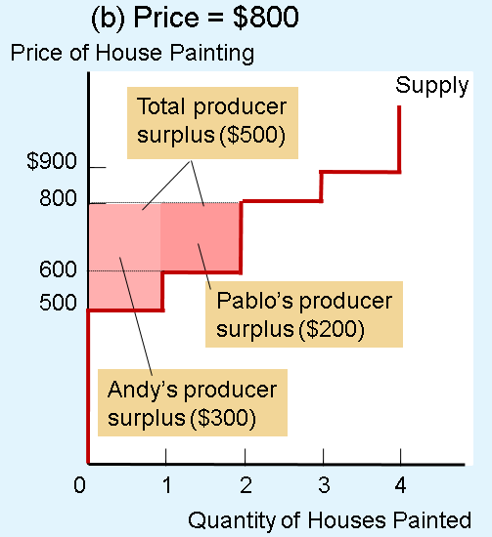
Figure 5 Measuring Producer Surplus with the Supply Curve
In panel (a), the price of the good is $600 and the producer surplus is $100.
In panel (b), the price of the good is $800 and the producer surplus is $500.

Slide 18
Producer Surplus, Part 4
A higher price raises producer surplus
Existing sellers: increase in producer surplus
Sellers who were already selling the good at the lower price are better off because they now get more for what they sell
New sellers enter the market: increase in producer surplus
Willing to produce the good at the higher price

Slide 19
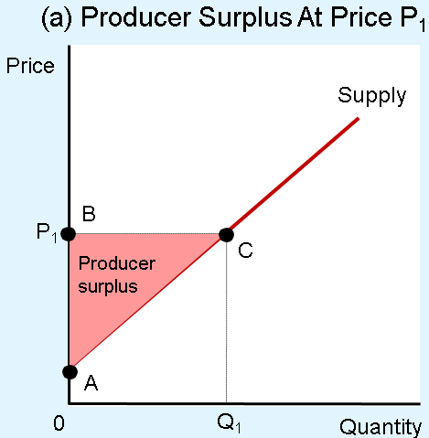
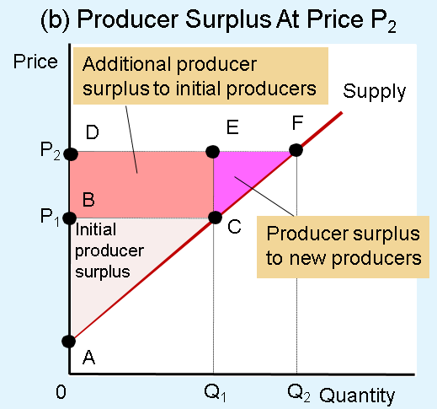
Figure 6 How Price Affects Producer Surplus
In panel (a), the price is P₁, the quantity supplied is Q₁, and producer surplus equals the area of the triangle ABC.
When the price rises from P₁ to P₂, as in panel (b), the quantity supplied rises from Q₁ to Q₂ and the producer surplus rises to the area of the triangle ADF. The increase in producer surplus (area BCFD) occurs in part because existing producers now receive more (area BCED) and in part because new producers enter the market at the higher price (area CEF).

Slide 20
Market Efficiency, Part 1
The benevolent social planner
All-knowing, all-powerful, well-intentioned dictator
Wants to maximize the economic well-being of everyone in society
Economic well-being of a society
Total surplus
Sum of consumer and producer surplus

Slide 21
Market Efficiency, Part 2
Total surplus = Consumer surplus + Producer surplus
Consumer surplus = Value to buyers – Amount paid by buyers
Producer surplus = Amount received by sellers – Cost to sellers
Amount paid by buyers = Amount received by sellers
Total surplus = Value to buyers – Cost to sellers

Slide 22
Market Efficiency, Part 3
Efficiency
Property of a resource allocation
Maximizing the total surplus received by all members of society
Equality
Property of distributing economic prosperity uniformly among the members of society

Slide 23
Market Efficiency, Part 4
Gains from trade in a market
Like a pie to be shared among the market participants
The question of efficiency
Whether the pie is as big as possible
The question of equality
How the pie is sliced
How the portions are distributed among members of society

Slide 24
Market Efficiency, Part 5
Market outcomes
Free markets allocate the supply of goods to the buyers who value them most highly
Measured by their willingness to pay
Free markets allocate the demand for goods to the sellers who can produce them at the least cost

Slide 25
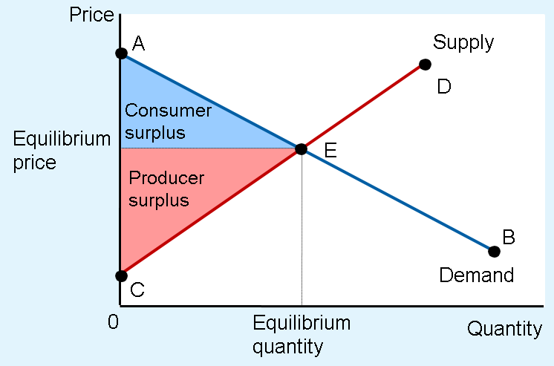
Figure 7 Consumer and Producer Surplus in the Market Equilibrium
Total surplus—the sum of consumer and producer surplus—is the area between the supply and demand curves up to the equilibrium quantity.

Slide 26
Market Efficiency, Part 6
At market equilibrium, social planner
Cannot increase economic well-being by
Changing the allocation of consumption among buyers
Changing the allocation of production among sellers
Cannot rise total economic well-being by
Increasing or decreasing the quantity of the good

Slide 27
Market Efficiency, Part 7
Market outcomes
Free markets produce the quantity of goods that maximizes the sum of consumer and producer surplus
Market equilibrium
Efficient allocation of resources
The benevolent social planner
“Laissez faire” = “let people do as they will”

Slide 28
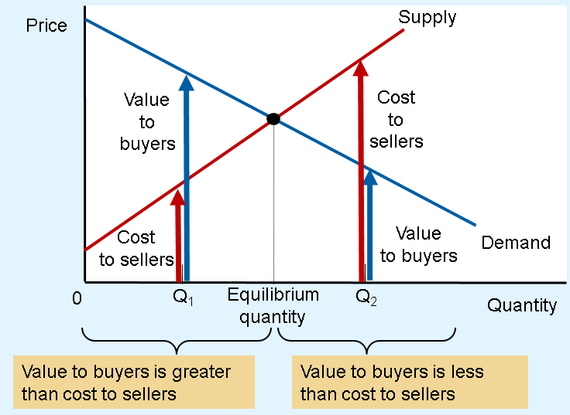
Figure 8 The Efficiency of the Equilibrium Quantity
At quantities less than the equilibrium quantity, such as Q1, the value to buyers exceeds the cost to sellers.
At quantities greater than the equilibrium quantity, such as Q2, the cost to sellers exceeds the value to buyers.
Therefore, the market equilibrium maximizes the sum of producer and consumer surplus.

Slide 29
Market Efficiency, Part 8
Adam Smith’s invisible hand
Takes all the information about buyers and sellers into account
Guides everyone in the market to the best outcome
Economic efficiency
Free markets
Best way to organize economic activity

Slide 30
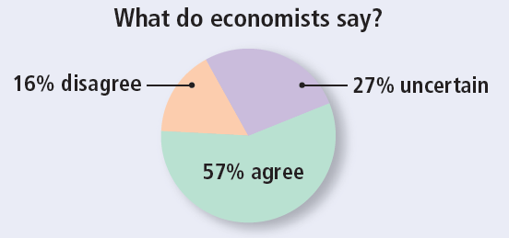
ASK THE EXPERTS
Supplying Kidneys
“A market that allows payment for human kidneys should be established on a trial basis to help extend the lives of patients with kidney disease.”

Slide 31
Should there be a market for organs? Part 1
“How a mother’s love helped save two lives”
Ms. Stevens - her son needed a kidney transplant
The mother’s kidney was not compatible
Donated one of her kidneys to a stranger
Her son was moved to the top of the kidney waiting list

Slide 32
Should there be a market for organs? Part 2
Questions
Trade a kidney for a kidney?
Trade a kidney for an expensive, experimental cancer treatment?
Exchange her kidney for free tuition for her son?
Sell her kidney for cash?

Slide 33
Should there be a market for organs? Part 3
Current public policy
Illegal for people to sell their organs
Government has imposed a price ceiling of zero: shortage
Large benefits to allowing a free market in organs
People are born with two kidneys
Usually need only one
Few people – no working kidney

Slide 34
Should there be a market for organs? Part 4
Current situation
Typical patient waits several years for a kidney transplant
Every year, thousands of people die because a kidney cannot be found

Slide 35
Should there be a market for organs? Part 5
Allow for kidney market
Balance supply and demand
Sellers get extra cash in their pockets
Buyers get to live
No more shortage of kidneys
Efficient allocation of resources

Slide 36
Should there be a market for organs? Part 6
Critics: worry about fairness
Benefit the rich at the expense of the poor
Current system: is it fair?
Some people have an extra kidney they don’t really need
Others are dying to get one

Slide 37
Market Efficiency & Market Failure, Part 1
Forces of supply and demand
Allocate resources efficiently
Several assumptions about how markets work
Markets are perfectly competitive
Outcome in a market matters only to the buyers and sellers in that market

Slide 38
Market Efficiency & Market Failure, Part 2
When these assumptions do not hold
“Market equilibrium is efficient” may no longer be true
In the world, competition is far from perfect
Market power
A single buyer or seller (small group)
Control market prices
Markets are inefficient

Slide 39
Market Efficiency & Market Failure, Part 3
In the world
Decisions of buyers and sellers
Affect people who are not participants in the market at all
Externalities - cause welfare in a market to depend on more than just the value to the buyers and the cost to the sellers
Inefficient equilibrium - from the standpoint of society as a whole

Slide 40
Market Efficiency & Market Failure, Part 4
Market failure
E.g.: market power and externalities
The inability of some unregulated markets to allocate resources efficiently
Public policy
Can potentially remedy the problem and increase economic efficiency

